Slide 1
ScheduleMaster ‘Hanger Talks’
02/18/2012
John Boutross
914-715-9322
jboutross@gmail.com

Slide 2
Agenda
Scheduling
Updating your profile
Resource Info
Squawks & Maintenance
Group Info
Telephone access
Flight Officers Authorization
Reports
Additional help available
Backup

Slide 3
Web Scheduling
Scheduling via ‘Calendar View’ or ‘List View’
Change via My Account => My Profile => Preferences
SQUAWKS: It is CRITICAL to click on icon when scheduling AND before flight to see open squawks on airplane! (Green, Yellow, Red icon indicates severity)
ALERT NOTIFICATION: Enables member to be notified if a particular reservation is cancelled and time is available for scheduling.
You still must sign on to ScheduleMaster and make reservation.
To set Alert”
Click icon in LIST view
Click on reservation in CALENDAR view to set alert
Schedule => My Sched Notif => Add
TAG: Allows member to enter a note about a particular reservation (List views only)

Slide 4
Updating Member Profiles My Account => My Profile
Contact:
Members can update info directly (also need to send updates to Treasurer)
Please add an emergency contact
Pilot/Personal:
Info on ratings and authorizations (Club updated)
Status:
Medical/BFR info (Club updated)
Member can update ‘Safety Pilot’ field if interested
Preferences:
Personalize ScheduleMaster views and notifications
Password:
Members can change their ScheduleMaster passwords

Slide 5
Resource (Airplane) Info Tab
Aircraft:
Lists basic information about airplanes (little used)
Other Resources: (not used)
Squawks:
View open and/or closed squawks
Enter new squawks
Scheduled Maintenance:
Lists near term (notifications sent) and future scheduled maintenance required
Maintenance Notifications: (Flight Officers and Club Officers):
Set email notifications for maintenance and squawks

Slide 6
‘Group Info’ Tab
Group Email: (Group Info => Group Email)
Used primarily by Club Officers or to notify all members when canceling long reservation
Contact Info: (little used)
Club info for ScheduleMaster
User List: Self explanatory
Messages:
List of messages from Reliant and Club Officers
Sched Policies: (little used)
Calculations used to implement Flying 20 policies
User Options and User Date Limits: (little used)
ScheduleMaster options selected for Flying 20 Club
Helpful Sites:
Web links to external aviation sites

Slide 7
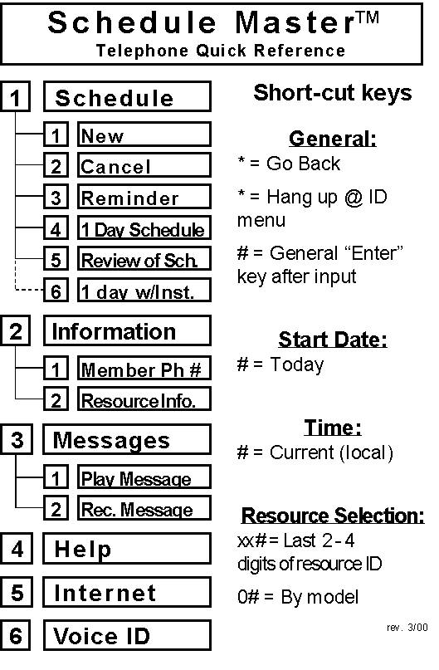
ScheduleMaster Telephone Access (800) 414-6114
NOTES:
Letters are entered by pressing the key with the corresponding letter. Use the 7 key for the letter Q, and the 9 key for the letter Z.
Dates are entered as 4 digits, MMDD. Example; April 4th = 0404# Time is entered as 4 digits in 24 hr. format, example; 7AM = 0700, noon = 1200, 11PM = 2300
Midnight can be a point of confusion. Midnight (2400) is actually 0000 the next day. Use 2359 for the end of each full day.
Simple way to cancel remaining time if you return early!!
Use same login credentials as on-line.

Slide 8
Flight Officers Authorization
Add/delete messages
General or for specific airplane
Group Info => Messages => New Messages
Enter Squawks for other users
Resource Info => Squawks => Enter New Squawk, select user from drop down menu
Close or delete Squawks
Resource Info => Squawks => Click on open squawks => click Close or Delete squawk
Overlay schedules and schedule more than 3
Please be careful and notify members if their schedules are overlayed
Administer Scheduled Maintenance
Please coordinate with Steve Desorbo

Slide 9
Reports Available to Club Officers
Usage reports (samples attached)
Member and Aircraft statistics
Online view of Medical / BFR Expired
Online list of members who have not scheduled in 3 or 6 months

Slide 10
More ScheduleMaster Help Needed?
ScheduleMaster Knowledge Base
Tutorials
Searchable on-line help and forums
New functions and announcements
Problem reporting
Access via ‘Technical Support’ link
John Boutross
914-715-9322 (cell)
203300-5207 (home)
jboutross@gmail.com

Slide 11
BACKUP

Slide 12
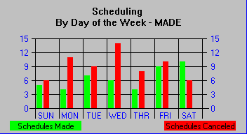
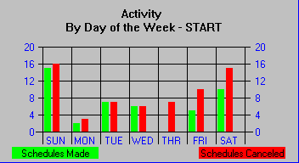
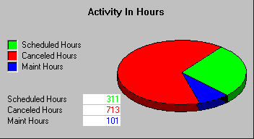
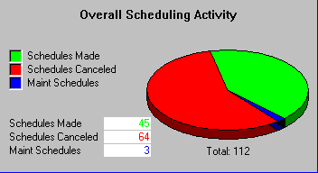
Overall Organizational Activity From Sunday, January 01, 2012 to Sunday, February 12, 2012 For Flying 20 Club, Inc.

Slide 13
RESOURCE AGGREGATION From Sunday, January 01, 2012 to Sunday, February 12, 2012
Manufacture /Model | Res N_NO | Location | Number of Schedules | Total Hours Scheduled | Average Duration | Number of Cancels | Hours of Maintenance
Piper P28B | 8107B | DANBURY MUNI | 13 | 188 | 14.95 | 19 | 92
Piper P28A | 455H | DANBURY MUNI | 24 | 88 | 2.56 | 36 | 9
Piper P28A | 8237B | DANBURY MUNI | 8 | 35 | 2.72 | 9 | 0

Slide 14
HIGH ACTIVITY RESOURCES From Sunday, January 01, 2012 to Sunday, February 12, 2012 WARNING - There may be other resources with equally high activity. This Table only reports the first.
Activity Description | Maximum Value | Resource ID | Manufacture Model
Longest Schedule Duration | 92 Hours | 8107B | Piper P28B
Most Hours Scheduled | 188 Hours | 8107B | Piper P28B
Most Number of Schedules Made | 24 | 455H | Piper P28A
Most Number of Canceled Schedules | 36 | 455H | Piper P28A

Slide 15
Thank You!

